Slide 1
Mini Design Review 2
Team 10:
Cainwyn Leung | Claire Kim
Selina Qin | Radhey Patel

Slide 2
Needs Statement
Revised Needs Statement
To prevent in-stent restenosis from plaque and cholesterol at the location of the stent being inserted into the carotid artery for patients undergoing an angioplasty, thus, to reduce restenosis in both drug-eluting and bare metal stent and to increase their long-term efficacy as well as safety

Slide 3
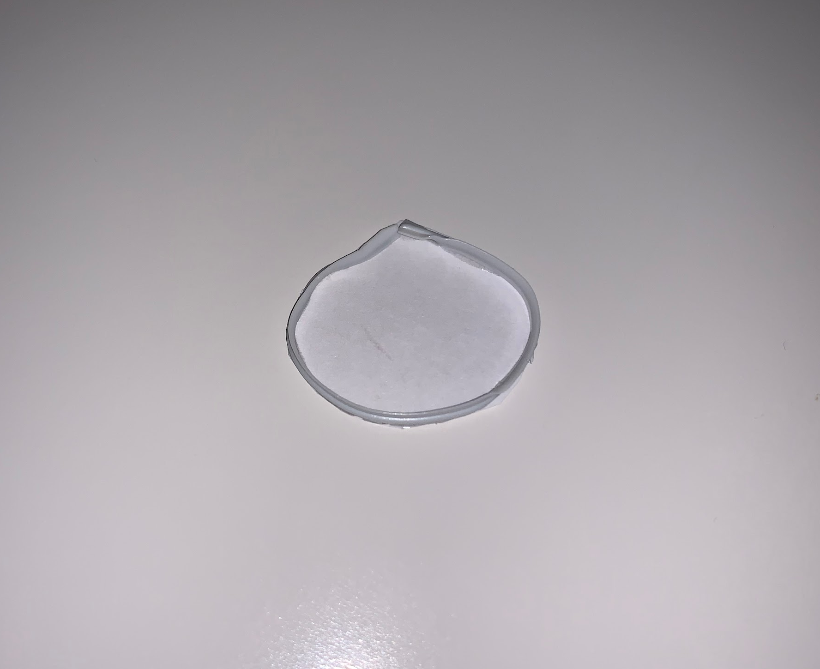
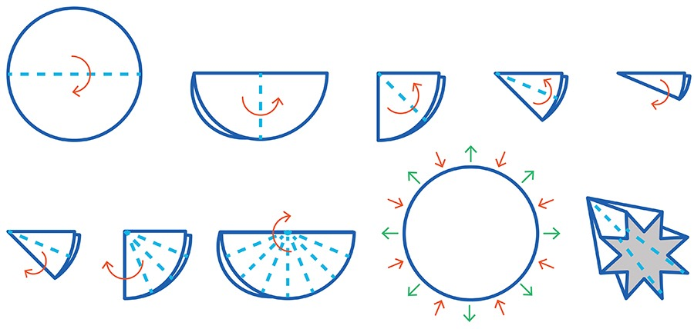
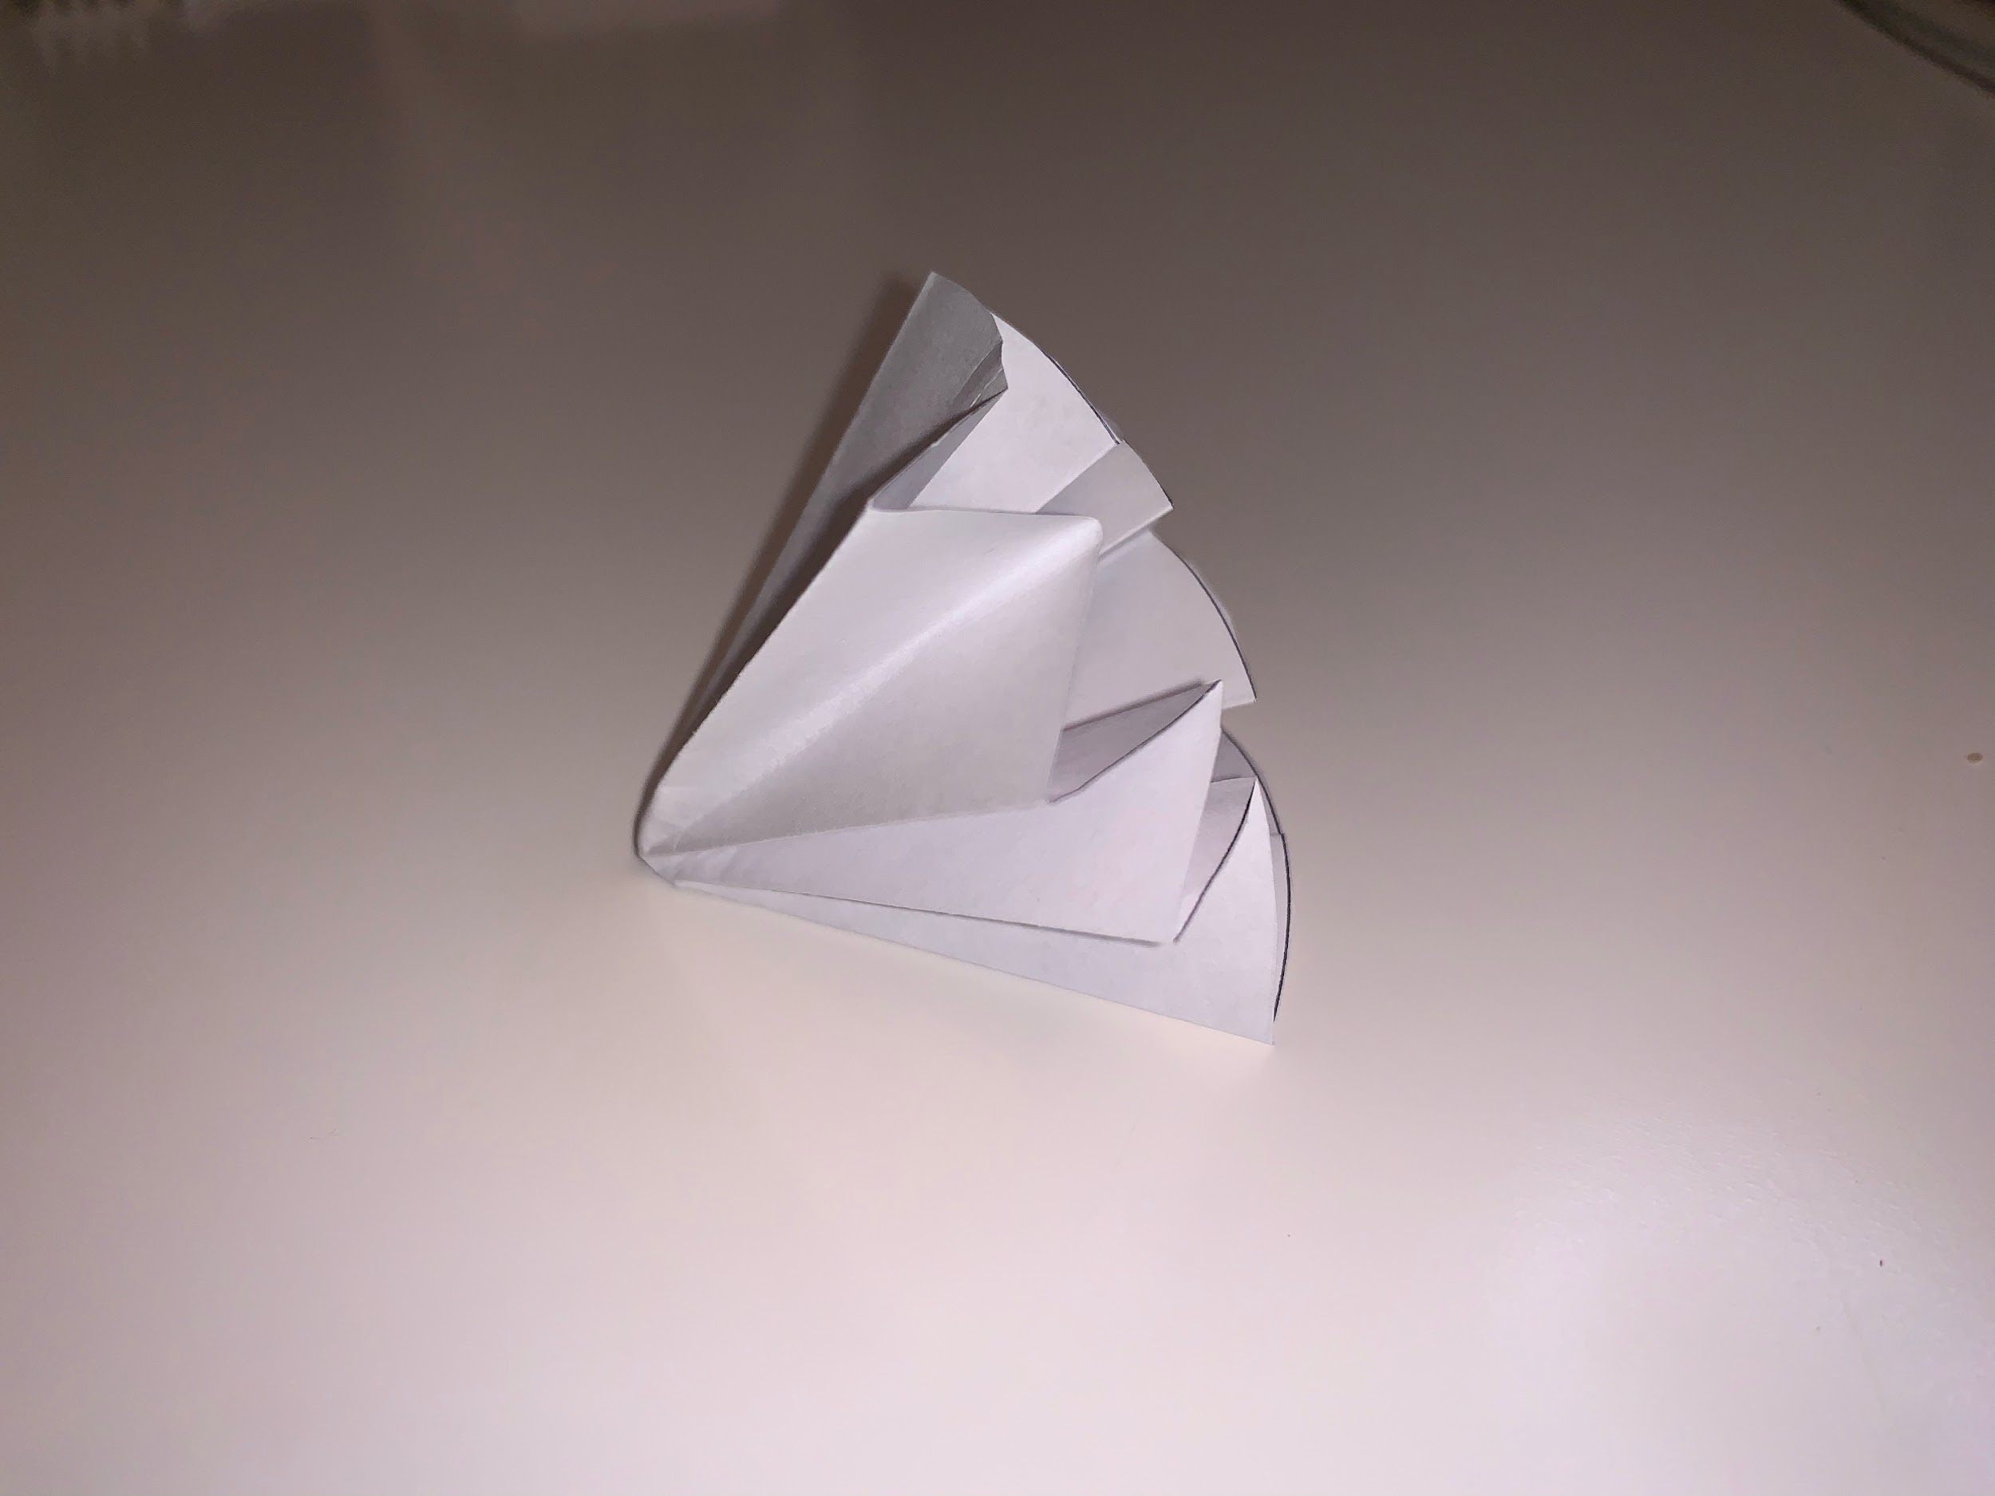
Looks-like Prototype
This looks-like prototype is constructed from a metal wire with a piece of circular filter paper attached to the front. The filter is then folded in to the optimal shape for insertion.

Slide 4
Killer Experiment
Rationale
Quantifiable risk assessment will return the risk of our product outweighing the current risk of in-stent restenosis
Objectives
To confirm if our product design is biocompatible enough and would not create any risks that can be fatal to patients when it stays in the patient's body for long time
Plan
Define killer questions by performing background researches and rough prototyping as well as consulting with professionals who work in the biomedical field

Slide 5
Killer Experiment
Measures:
Efficacy rates against restenosis during A/B Testing of the product
Quantity of Plaque- accumulation on one the surface of the filter/-eliminated from the blood flow
Targets:
Block Particle Sizes: 32–55% that cause restenosis
Reducing Restenosis rate to under the current rate of 17-32%
Product Lifespan: 10-15 years

Slide 6
Killer Experiment
Limitations:
Possibility of blocking out other lipids that are essential to our body, depending on its structure and size
Wrong material or location selection of the filter might lead to serious tissue damaging, creating more risks for patients

Slide 7
Works-like Prototype Timeline
DAY 1
DAY 2
DAY 3
DAY 4
DAY 5
Selecting & Ordering
Materials
Testing
1
2
3
4
CAD Model Complete
Prototype Manufacturing

Slide 8
THANKS
Does anyone have any questions?

